Slide 1
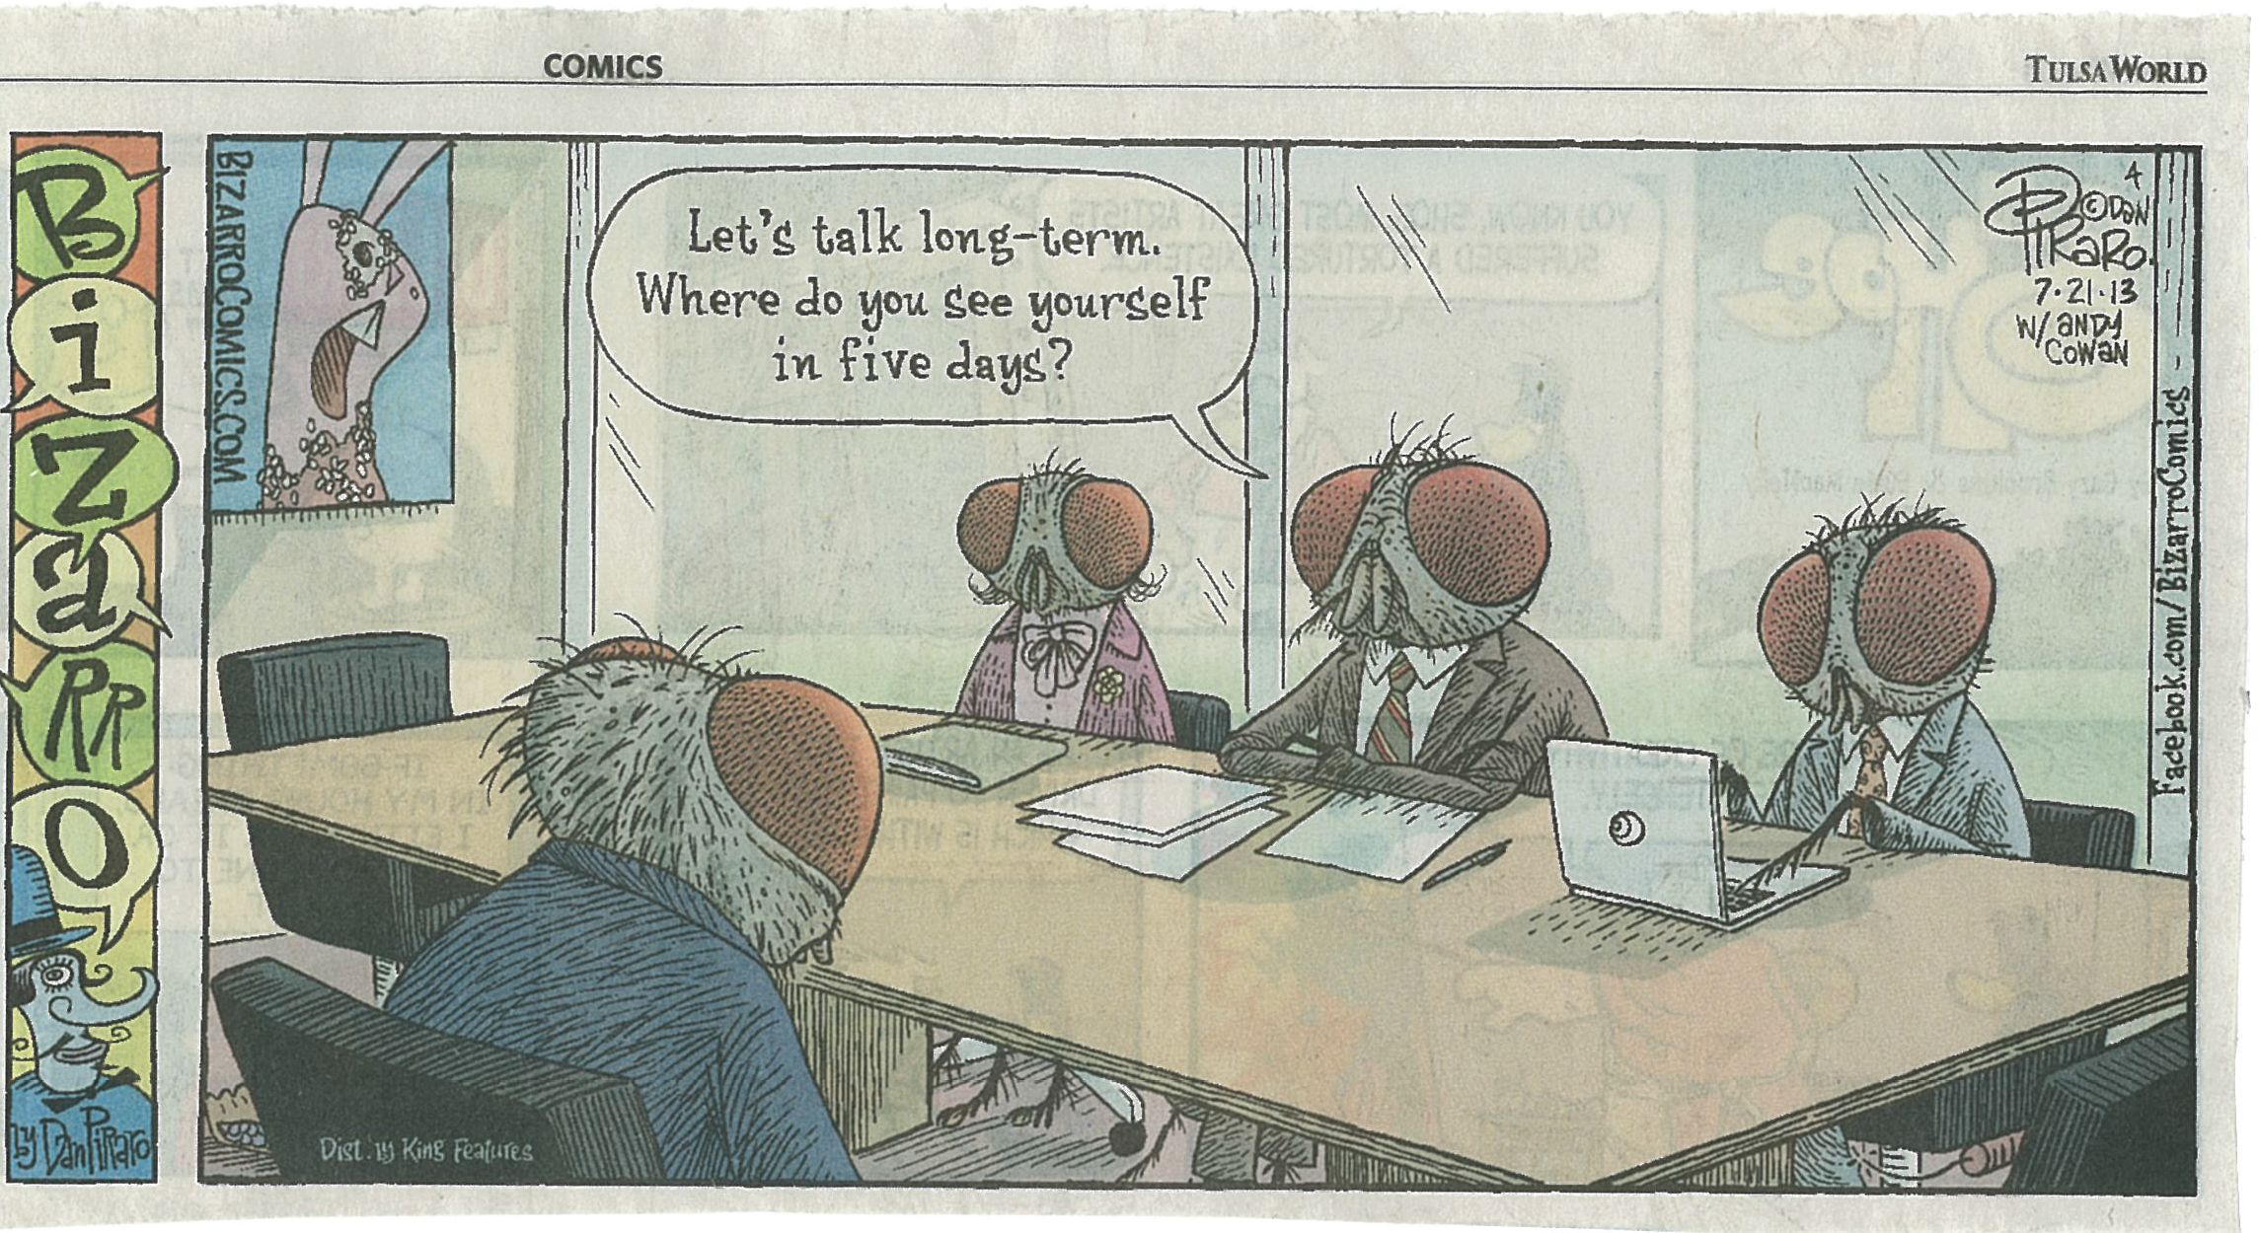

Slide 2
BYU students and faculty are the key reason we exist. We will align our strategy and resources (people, collections, services, and spaces) to provide the best possible outcome for them. We will do this by:

Slide 3
1. Improving discoverability of and access to resources—especially those unique to BYU—in order to support scholarship and to maximize our investment in acquiring and preserving this material
Diagnosis: Our investment in collections, services, and spaces is underperforming because we are not creating appropriate access to those resources.
Guiding Policy: Our primary customers will guide us in determining what is appropriate access.
Actions:
Notes:
Often there is too much, too little, we’re not taking full advantage of technologies (i.e., that harvest the metadata we’re creating), we’re not integrated into campus assets in an ubiquitous way (i.e., in LearningSuite), and we have important collections that have yet to be digitized. According to Rumelt, good guiding policy draws upon advantage. What are our advantages? We have outstanding collections, an amazing physical facility, some services that are already extremely popular and highly valued, and staff that are second to none.

Slide 4
2. Providing spaces that facilitate collaboration, experimentation, creation, and discovery
Diagnosis: We view the HBLL as “our space”—not as space that should best serve the needs of BYU students and faculty—to the point that we are not viewed as a key extension of the classroom or laboratory.
Guiding Policy: HBLL space exists to support learning and scholarship.
Actions:
Notes:
What are our advantages? Again, we have an amazing physical facility in terms of size, location on campus, and in aesthetics (in some places). We have about 3 million visitors to the Library annually.

Slide 5
3. Fostering deep collaboration that produces new knowledge (research) and facilitates learning
Diagnosis: A few shining examples aside, professorial faculty and, by default, students largely consider the library an add-on to what they’re doing in the classroom or in their lab, if they consider us at all.
Guiding Policy: Teaching and scholarship that strengthens relationships with faculty in the colleges or contributes in a demonstrable way to achieving positive student learning outcomes will be highlighted and rewarded.
Actions:
Notes:
What are our advantages? We have an extremely well educated faculty and staff with a wide array of subject expertise. We have nationally regarded experts in cataloging and metadata creation. We have a highly talented LIT staff. We should be playing a bigger role in research and learning on this campus.

Slide 6
Key Steps in Developing Coherent Actions
Develop personas for major groups to create highly focused actions.
Establish standards of success for physical and virtual transactions for each persona.

Slide 7
Key Steps, continued…
Identify skills we need to develop but don’t currently have (at all or not in sufficient numbers)
Identify services/needs that students and/or faculty have expressed interest in that we can’t meet. Experiment on a small scale in delivering/ addressing those that would have a high impact on learning or scholarship.
Create an inventory of spaces needed for learning and scholarship that are not being adequately met on campus. Decide which ones we can address.
Notes:
Where are the gaps?

Slide 8
“Rules” for developing coherent actions
All actions must address how we will:
Develop our people so they can lead/ facilitate/respond to the changes we need to address
Communicate internally and externally in ways that are strategic and holistic

